Slide 1

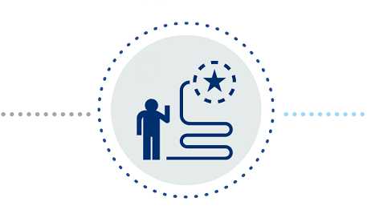
BUSINESS PROBLEM AND OBJECTIVE
IDENTIFY POTENTIAL CUSTOMERS THAT WILL SUBSCRIBE TO TERM DEPOSIT
With Available Data and Correct Decision Centric Approach
Reach out to potential customers
Reduce Spending on Advertising

Slide 2
HANDLING THE BUSINESS PROBLEM
RESOURCE AVAILABILITY TACKLING BUSINESS PROBLEM
Kaggle
Python
Python
Choosing right data
Preprocess the data
Build Models and Evaluate
Choosing the right model
Dataset
Preprocessing & Visualization
Modeling

Slide 3
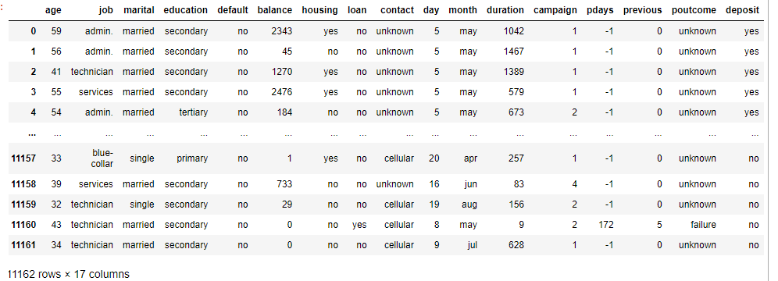
DATASET
TARGET
17 COLUMNS
11162 ROWS

Slide 4
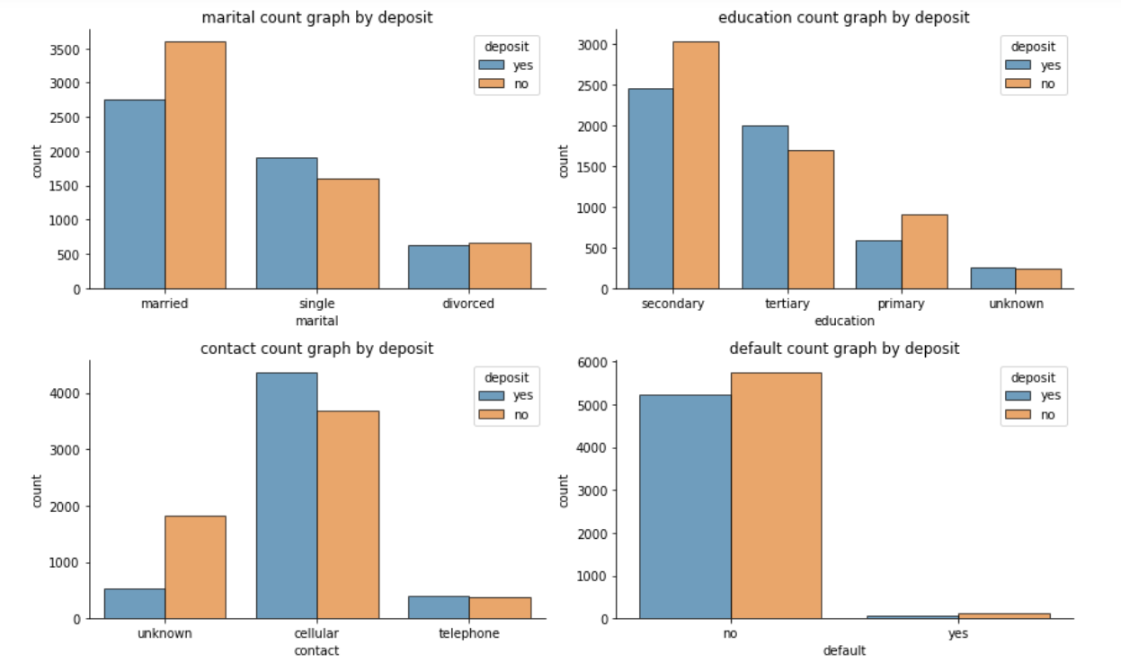
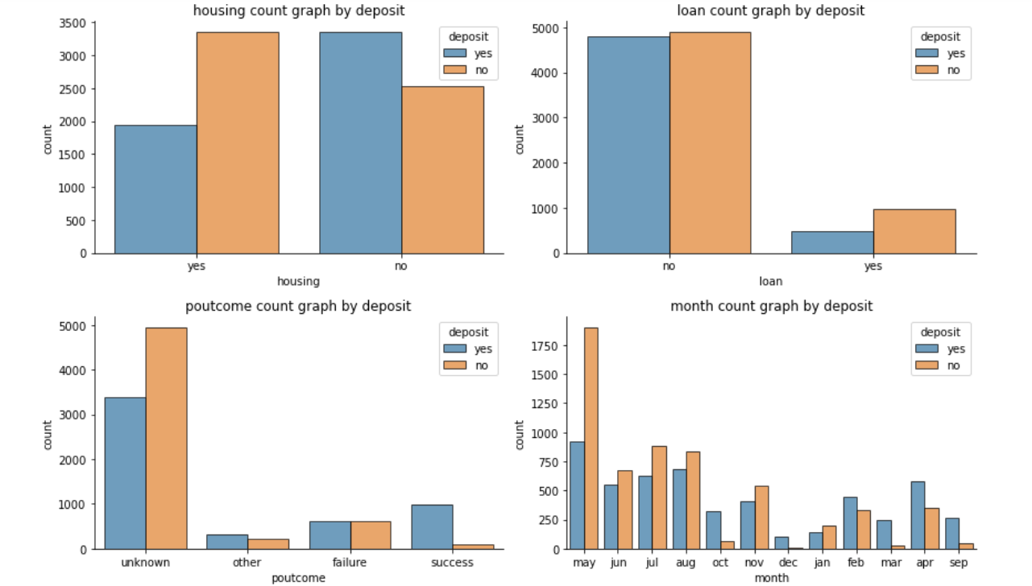
Dataset Attribute Exploration

Slide 5
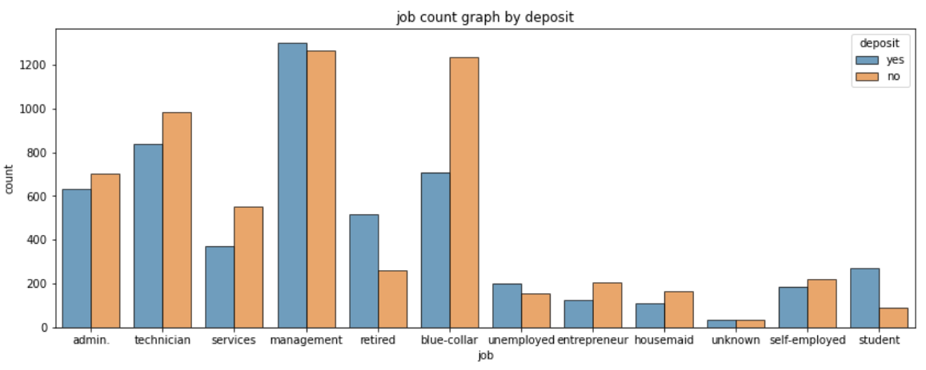
Dataset Attributes Exploration

Slide 6
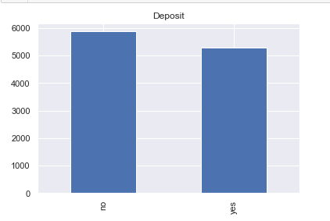
Balanced Dataset

Slide 7
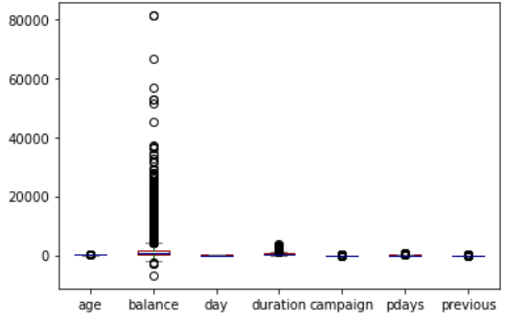
OUTLIERS

Slide 8
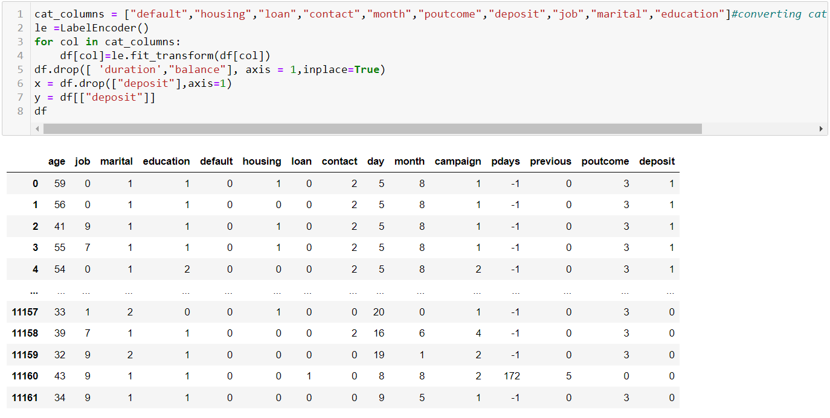
Converting Categorial Variables

Slide 9
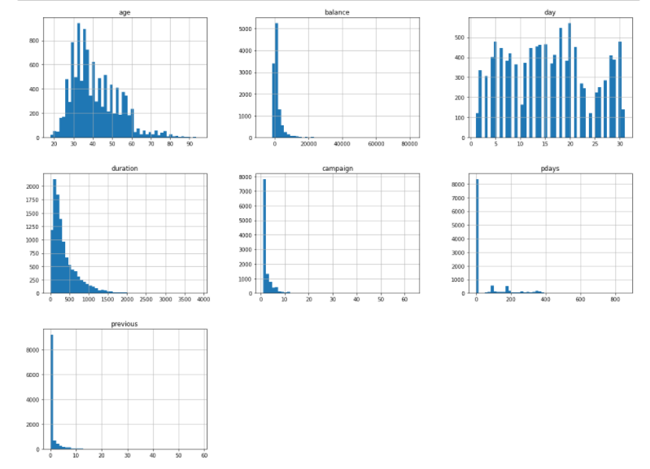
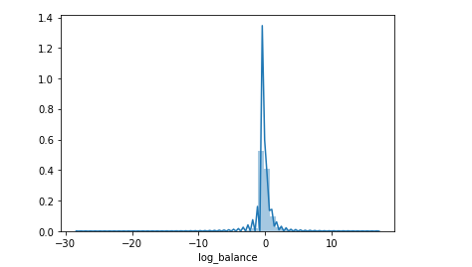
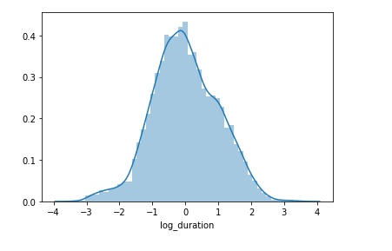
Skewed Data and Transformation

Slide 10
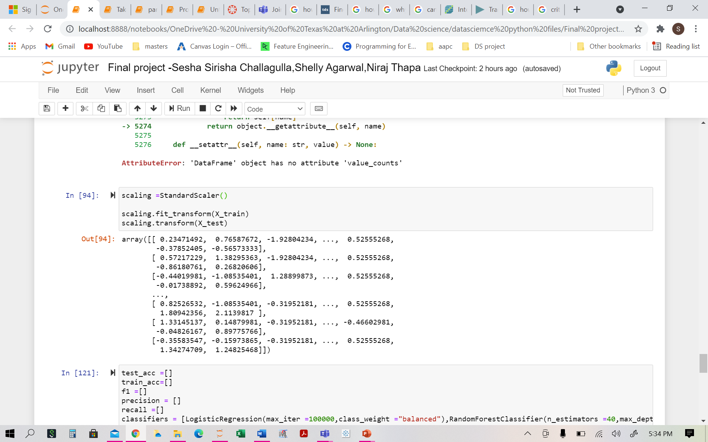
Data Scaling

Slide 11
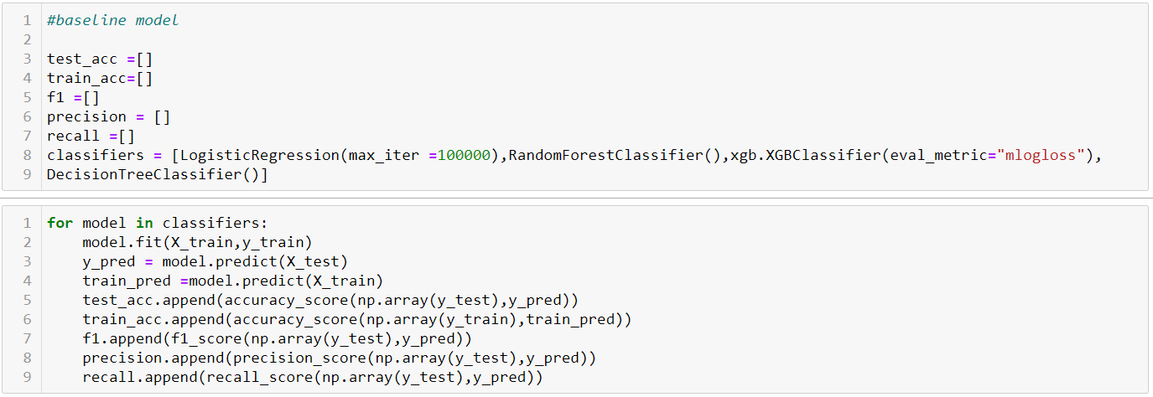
algorithms

Slide 12
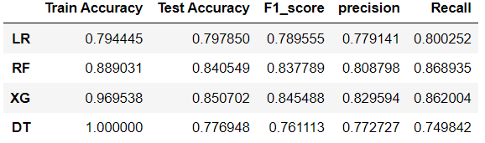
Model evaluation

Slide 13
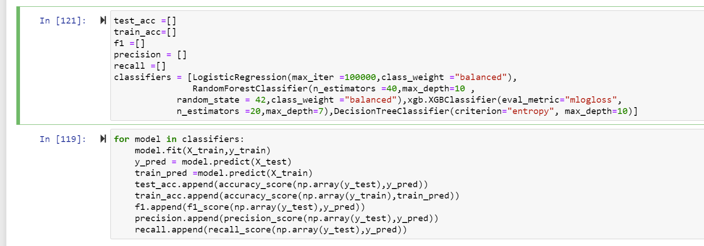
Fine tuning parameters

Slide 14
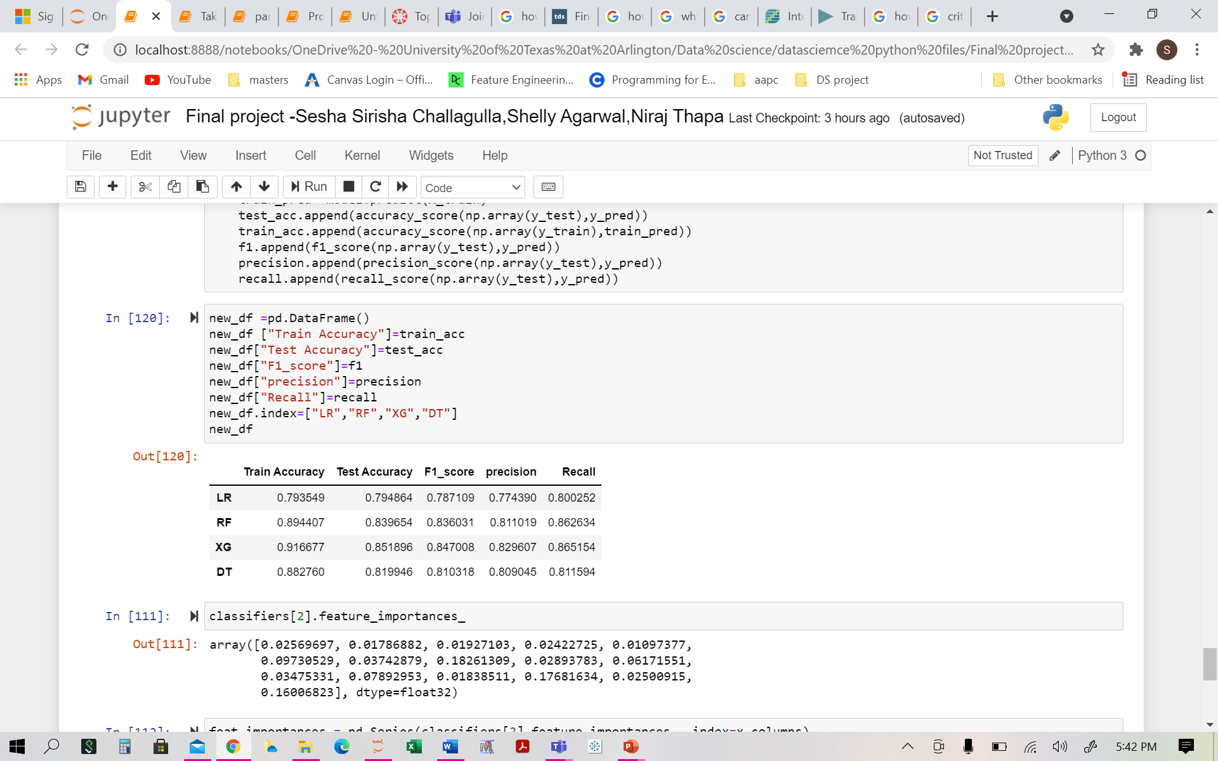
Fine tuning model evaluation

Slide 15
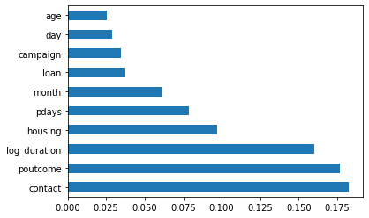
Feature Importance

Slide 16
Limitation
Even though Contact is the top feature, we cannot rely on it alone to target customer for future campaigns.

Slide 17
Conclusion
Use the best (XG) model on future datasets.
Focus on the top attributes as shown by Feature Importance.

